Slide 1
Neo4j – Graph Database

Slide 2
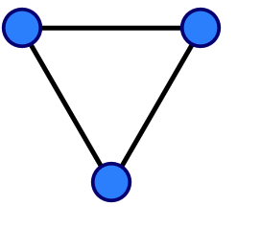
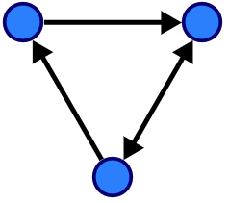
What is Graph
A graph is a structure amounting to a set of objects in which some pairs of the objects are in some sense "related".
The objects correspond to vertices ( also called as nodes).
Each of the related vertices are connected through an edge (also called as link). These links define the relationships between nodes.
Edge can be directed or undirected.
The structure of how nodes and relationships are connected to each other makes a graph.
John
Friend of
Colleagues
Alice
Wife of
Bob
A graph with three vertices and three edges
A directed graph with three vertices and four directed edges

Slide 3
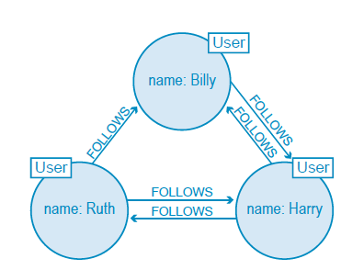
What is Graph Database
A Graph Database uses highly inter-linked data structures built from nodes, relationships and properties.
The most widely used model for graph databases is the labeled property graph model.
The fundamental components of the labeled property graph model are nodes and relationships (you may also know these as vertices and edges) and constraints.
Each node represents an entity (a person, place, thing, category or other piece of data). You can optionally add label(s) to a node, which indicates the node’s role in the graph.
Each relationship represents how two nodes are associated/linked. Relationships are singly typed, directed or self referencing and has start and end node. Any number of relationships of any type, in any direction can be attached to a node.
Properties are the attributes associated with a node or relationship. Properties are name-value pairs, where the name of the property comes first and then its value. Data Type of a property can be string, integer, spatial or temporal.
Twitter is a typical example of Graph Database. Below Graph data model represents nodes (labeled “User”) belonging to single person and is connected with relationships describing how each user is connected.

Slide 4
What is Graph Database
Labels are a way of semantically categorizing the nodes in your graph. A node can have zero, one, or more labels assigned to it.
Graph databases are general-purpose NoSQL data technology. They can be used by a wide variety of domains.
A graph database builds a network of interconnected entities to represent its domain.
The key to understanding when to use a graph database is the value of links(or relationships between nodes). If data is connected then graph databases are going to be a good choice.
By declaring constraints, database enforce that certain properties must be present for certain node labels or relationship types or certain fields have unique values.
Graph databases are schema-less or optional schema and hence allow to grow data organically with the evolving requirements.
Graph databases represent data in a much more natural way and enables to apply various types of Graph Algorithms to traverse the graph like BFS, DFS.
Graph databases provides capability to traverse graph from one node to another by following the relationships. This capability is referred as index free adjacency which essentially means that you can find adjacent/neighbouring nodes without having to do an index lookup--is key to the performance characteristics.

Slide 5
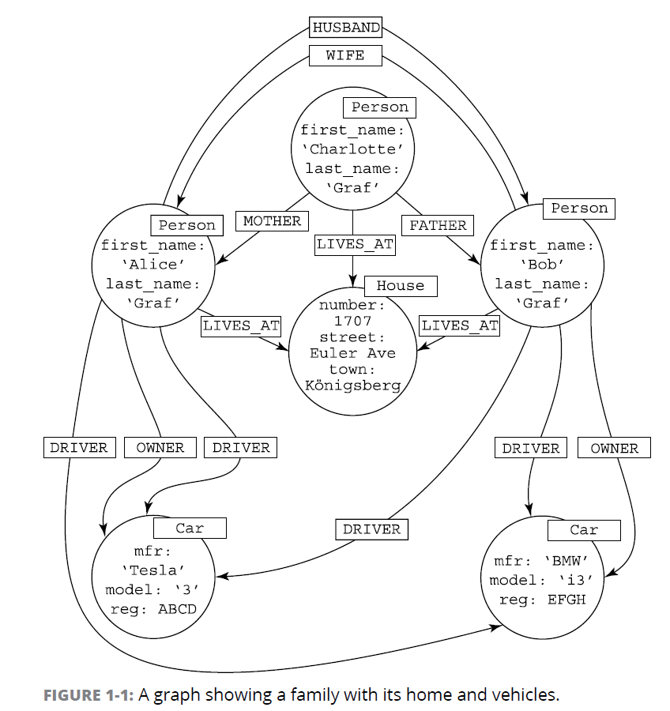

Slide 6
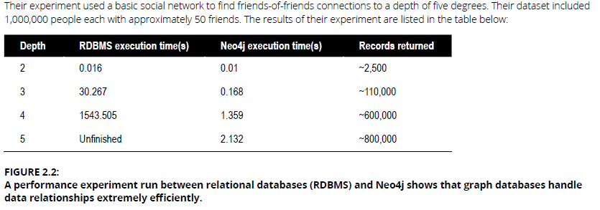
Why use Graph Databases
Performance :Graph database performance stays consistent with the increasing volume of data.
Graph Databases are incredibly efficient when it comes to query speeds, even for deep and complex queries.
Flexibility : Graph Data Models offer flexibility to add new data without exhaustively modeling ahead of time and without impacting any existing functionality. This enables development with the speed of business because the structure and schema of a graph data model flex as your solutions and industry change
Agility : Developing with graph databases aligns perfectly with today’s agile, test-driven development practices, allowing your graph-database backed application to evolve alongside your changing business requirements
Ease : Graph data models are intuitive, more expressive and easily understandable. Also, Graph Data Models can be developed quickly based on a natural understanding and visual representation of the relationships between business entities. We can easily refine model for new and changing requirements with a simple whiteboard session with business team.

Slide 7
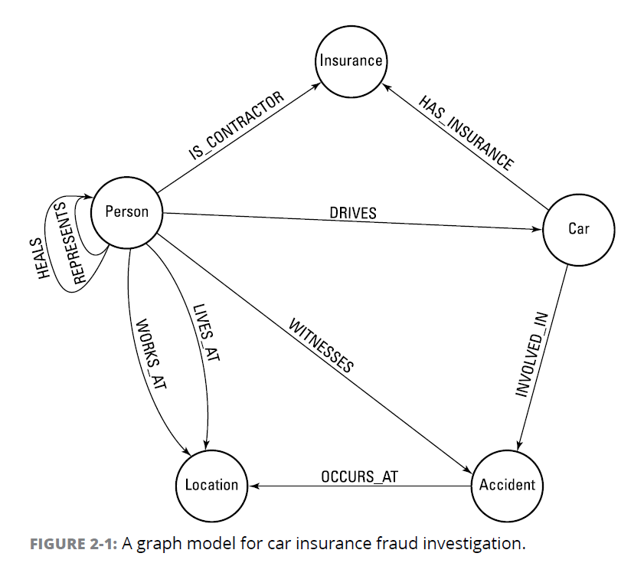
The best way to start developing a graph data model is to ask business domain experts to use a whiteboard to explain their requirements. Chances are they’ll start drawing circles and arrows explaining the flow of information, processes, and key entities and the relationships between them. Business domain experts build the model right before your eyes.
This is rich data model that’s easy to understand and is like a schema for a graph at modeling level.
At implementation level, graphs are populated by the instance of data.
There will be as many Person nodes and Car nodes as there are people and cars in the system. There will be as many DRIVES relationships as necessary to show the people who are car drivers.
People naturally think about their data in this way, so the first iteration of your graph model is rarely difficult. It requires only a whiteboard, pens, and time for discussion.

Slide 8
Why use Graph Databases
Graph Databases offer superior querying of complex models, enabling business to ask pertinent questions with high performance.
The complex join-intensive queries (in a relational database) are extremely simple, efficient, and fast in a graph structure.
In a graph database, a join operation will never need to be performed because the join operations are effectively pre-calculated and explicitly persisted in the database based on the relationships that connect nodes together. All we need to do is to find a starting node in the database, usually with an index lookup, and then just use the index-free adjacency characteristic and hop from one node to the next over its connecting relationships.
Every hop along this path is, in effect, the equivalent of a join operation.
Graph DB queries are pattern matching queries. We specify a pattern in query and based on that pattern one or more nodes are anchored as starting points and traverse through the matching occurrences of that pattern. The database will only explore the vicinity of that starting node and will be completely oblivious to anything that is not connected to the starting node. This implies that query performance is very independent of the dataset size, because in most graphs, everything is not connected to everything.

Slide 9
Graph Databases Use Case

Slide 10
Graph Database vs Relational DB

Slide 11
Neo4j - Graph Databases
Neo4j is leading Graph Database.
It is Transactional ACID compliant Database.
Neo4j is made for Online Transaction Processing (OLTP) systems.
Designed to support critical scalability, high availability and fault-tolerance. This is achieved through the cluster of database server instances that work together.
The complex join-intensive queries (of a relational database) are extremely simple, efficient, and fast in a graph structure.
Neo4j is implemented in Java and is Open Source.
Neo4j offers dedicated memory management and memory-efficient operations.
Neo4j is scalable and can be deployed as a standalone server or across multiple machines in a fault-tolerant cluster for production environments.
For production applications, Neo4j offers hot backups and extensive monitoring.
Neo4j uses semantic versioning. Neo4j’s fully managed cloud service is Neo4j Aura and uses only MAJOR versioning.

Slide 12
Neo4j - Graph Databases
Neo4j does not have tables, there are no JOINs to worry about.
Neo4j uses the property graph approach, where relationships are stored alongside the data in the model, and not computed at query time.
Neo4j graph database has query language called Cypher. Cypher is a declarative, pattern-matching, powerful, graph-optimized query language that makes graph database management systems understandable and workable for any database user.
The recommended way of programmatically interacting with the database is either through the official Neo4j Drivers, or through using the Java Reference → Neo4j Java API.
Neo4j provides an ACID complaint transactional backend for applications.
The official Neo4j Drivers interacts with Neo4j via the Bolt protocol.
Other Neo4j Tools
Neo4j Cypher Shell - Command line tool for Cypher queries.
Neo4j Browser - Interact with Neo4j, create Cypher queries, and basic visualization capabilities.
Neo4j Desktop - Developer IDE or Management Environment for Neo4j instances.
Neo4j Bloom - Explore and visualize graph data.
There are two editions of Neo4j to choose from, the Community Edition and the Enterprise Edition.
Notes:
The Bolt network protocol is a highly efficient, lightweight client-server protocol designed for database applications. It operates over a TCP connection or WebSocket. The Bolt protocol is statement oriented, allowing a client to send statements, each consisting of a single string and a set of typed parameters. The server responds to each request with a result message and an optional stream of result records.

Slide 13
Neo4j – Key Features
Feature | Community Edition | Enterprise Edition
Property graph model | ✔ | ✔
Native graph processing & storage | ✔ | ✔
ACID-compliant transactions | ✔ | ✔
Cypher graph query language | ✔ | ✔
Neo4j Browser with syntax highlighting | ✔ | ✔
Bolt Protocol | ✔ | ✔
Language drivers for C#, Java, JavaScript & Python [1\] | ✔ | ✔
High-performance native API | ✔ | ✔
High-performance caching | ✔ | ✔
Cost-based query optimizer | ✔ | ✔
Graph algorithms library to support AI initiatives [1\] | ✔ | ✔
Fast writes via native label indexes | ✔ | ✔
Composite indexes | ✔ | ✔
Full-text node & relationship indexes | ✔ | ✔
Store copy | ✔ | ✔
Auto-reuse of space | ✔ | ✔
Multiple databases (beyond the system and default databases) | ✖ | ✔
Slotted and Pipelined Cypher runtimes | ✖ | ✔
Property-existence constraints | ✖ | ✔
Node Key constraints | ✖ | ✔
Listing and terminating running queries | ✖ | ✔
Role-based access control | ✖ | ✔
Sub-graph access control | ✖ | ✔
LDAP and Active Directory integration | ✖ | ✔
Kerberos security option | ✖ | ✔

Slide 14
Neo4j – Performance and Scalability Features
Feature | Community Edition | Enterprise Edition
Causal Clustering for global scale applications | ✖ | ✔
Enterprise lock manager accesses all cores on server | ✖ | ✔
Intra-cluster encryption | ✖ | ✔
Offline backups | ✔ | ✔
Online backups | ✖ | ✔
Encrypted backups | ✖ | ✔
Rolling upgrades | ✖ | ✔
Automatic cache warming | ✖ | ✔
Routing and load balancing with Neo4j Drivers | ✖ | ✔
Advanced monitoring | ✖ | ✔
Graph size limitations | 34 billion nodes, 34 billion relationships, and 68 billion properties | No limit
Bulk import tool | ✔ | ✔
Bulk import tool, resumable | ✖ | ✔

Slide 15
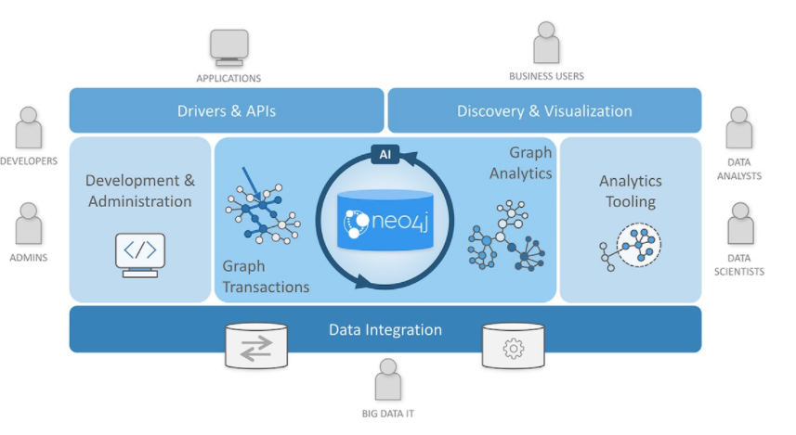
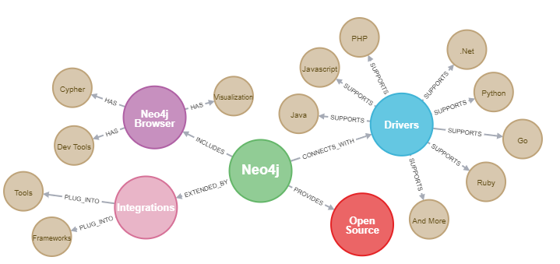
Neo4j - Graph Platform
Neo4j has following product suite that was built to meet business and technical need to maximize business value from the data.
Neo4j Graph Database
Neo4j Desktop
Neo4j Bloom
Neo4j Aura
Neo4j Browser
Graph Data Science
APOC
GraphQL and GRANDStack
ETL Tool

Slide 16
Raft Consensus Algorithm
Raft is a consensus algorithm that offers a generic way to distribute a “state machine” across a cluster of computing systems, ensuring that each node in the cluster agrees upon the same series of state transition.
Raft is named after Reliable, Replicated, Redundant, And Fault-Tolerant.
Raft achieves consensus via an elected leader. A server in a raft cluster is either a leader or a follower, and can be a candidate in the precise case of an election (leader unavailable). The cluster has one and only one elected leader. The leader is responsible for log replication to the followers. A leader leads until it fails or disconnects, in which case a new leader is elected. It regularly informs the followers of its existence by sending a heartbeat message. Each follower has a timeout (typically between 150 and 300 ms) in which it expects the heartbeat from the leader. The timeout is reset on receiving the heartbeat. If no heartbeat is received the follower changes its status to candidate and starts a leader election.
Log Replication: The leader is responsible for the log replication. It accepts client requests. Each client request consists of a command to be executed by the replicated state machines in the cluster. After being appended to the leader's log as a new entry, each of the requests is forwarded to the followers as AppendEntries messages. Once the leader receives confirmation from the majority of its followers that the entry has been replicated, the leader applies the entry to its local state machine, and the request is considered committed. This event also commits all previous entries in the leader's log. Once a follower learns that a log entry is committed, it applies the entry to its local state machine. This ensures consistency of the logs between all the servers through the cluster, ensuring that the safety rule of Log Matching is respected.

Slide 17
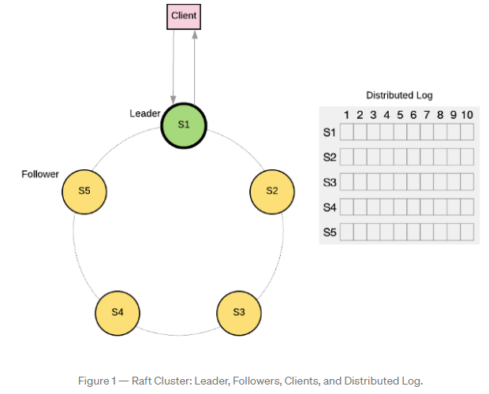
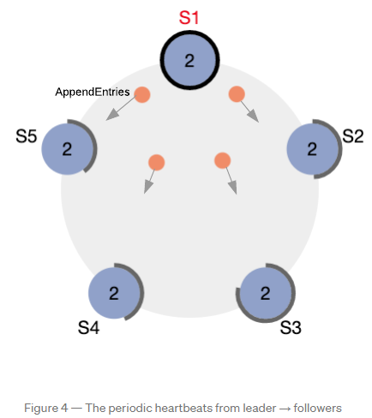
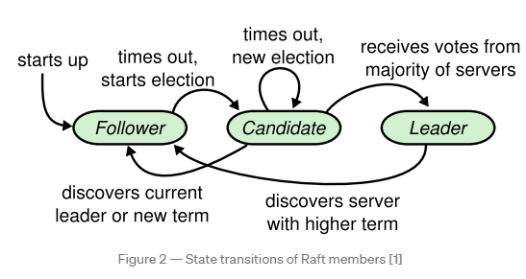
Raft Consensus Algorithm

Slide 18
Causal Consistency
Causal Consistency is one of the major memory consistency models.
Consistency Models are used in distributed systems like distributed data stores, databases, file systems, replication systems etc.
The data consistency model specifies a contract between programmer and system, wherein the system guarantees that if the programmer follows the rules, memory will be consistent and the results of reading, writing, or updating memory will be predictable.
Consistency deals with the ordering of operations to multiple locations with respect to all processors.
Causal consistency categorize events into those causally related and those that are not. It defines that only write operations that are causally related, need to be seen in the same order by all processes.
Causal consistency captures the potential causal relationships between operations, and guarantees that all processes observe causally-related operations in a common order. In other words, all processes in the system agree on the order of the causally-related operations.
Example :
If some process performs a write operation A, and some (the same or another) process that observed A then performs a write operation B, then it is possible that A is the cause of B; we say that A “potentially causes” or “causally precedes” B.
Causal Consistency guarantees that if A causally-precedes B, then every process in the system observes A before observing B.
Conversely, two write operations C and D are said concurrent, or causally independent, if neither causally precedes the other. In this case, a process may observe either C before D, or D before C.

Slide 19
Causal Consistency
Process P2 observes, reads the earlier write W(x)1 that is done by process P1.
The process P2 then write W(x)2.
The two writes W(x)1 and W(x)2 are causally related.
Under causal consistency, every process observes W(x)1 first, before observing W(x)2.
The two write operations W(x)2 and W(x)3, with no intervening read operations, are concurrent, and processes P3 and P4 observe (read) them in different orders.
P1 : | W(x)1 |  | W(x)3
P2 : | R(x)1 | W(x)2
P3 : | R(x)1 |  |  | R(x)3 | R(x)2
P4 : | R(x)1 |  |  | R(x)2 | R(x)3
The causal consistency model can be refined into four session guarantees.
Read Your Writes: If a process performs a write, the same process later observes the result of its write.
Monotonic Reads: the set of writes observed (read) by a process is guaranteed to be monotonically non-decreasing.
Writes Follow Reads: if some process performs a read followed by a write, and another process observes the result of the write, then it can also observe the read (unless it has been overwritten).
Monotonic Writes: If some process performs a write, followed some time later by another write, other processes will observe them in the same order.

Slide 20
Neo4j – Causal Cluster Architecture
From an operational point of view, the cluster is composed of servers with two different roles: Cores and Read Replicas.
The two roles are foundational in any production deployment but are managed at different scales from one another and undertake different roles in managing the fault tolerance and scalability of the overall cluster.
Neo4j’s Causal Clustering provides three main features:
Safety: Core Servers provide a Fault Tolerant platform for transaction processing which will remain available while a simple majority of those Core Servers are functioning. High availability is achieved via the causal cluster architecture. If a server fails the other core servers will automatically handle the requests.
Scale: Read Replicas provide a massively Scalable platform for graph queries that enables very large graph workloads to be executed in a widely distributed topology.
Causal consistency: when invoked, a client application is guaranteed to read at least its own writes.
Together, this allows the end-user system to be fully functional and both read and write to the database in the event of multiple hardware and network failures and makes reasoning about database interactions straightforward.

Slide 21
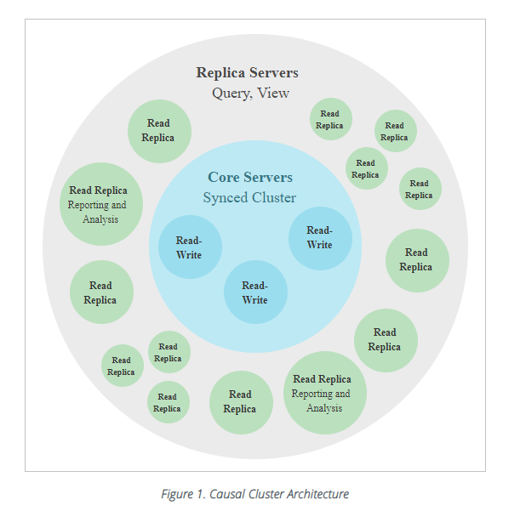
Neo4j – Causal Cluster Architecture
Core Servers :
In a Cluster, one Core Server is a leader elected by other core servers.
Its main responsibility is to safeguard data by replicating all transactions using the Raft protocol.
Raft ensures that the data is safely durable before confirming transaction commit to the end user application.
Once a majority of Core Servers in a cluster (N/2+1) have accepted the transaction, it is safe to acknowledge the commit to the end user application.
In practice there are relatively few machines in a typical Core Server cluster, enough to provide sufficient fault tolerance for the specific deployment.
This is calculated with the formula M = 2F + 1 where M is the number of Core Servers required to tolerate F faults.
The smallest fault tolerant cluster, a cluster that can tolerate one fault, must have three Cores.
They do query routing along with the bolt protocol drivers.

Slide 22
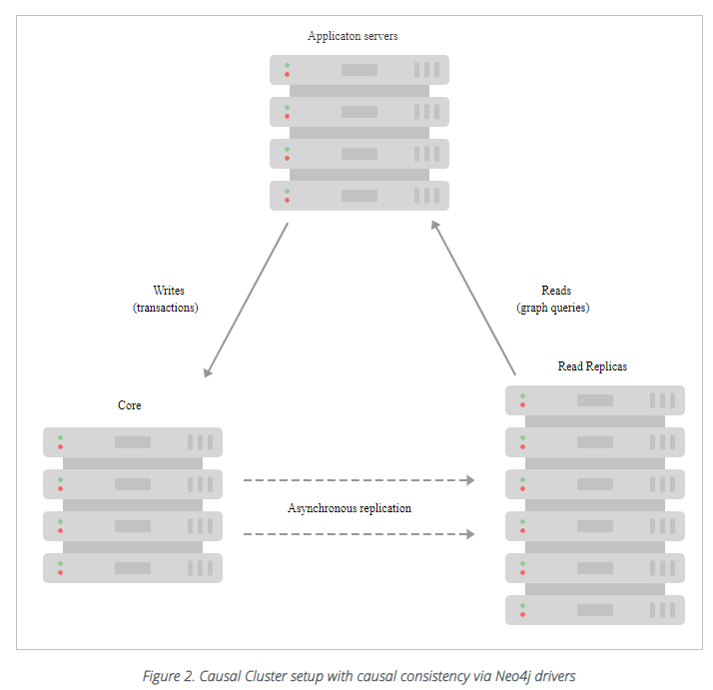
Neo4j – Causal Cluster Architecture
Read Replicas :
The main responsibility of Read Replicas is to scale out graph workloads.
Read Replicas act like caches for the graph data that the Core Servers safeguard and are fully capable of executing arbitrary (read-only) queries and procedures.
Read Replicas are asynchronously replicated from Core Servers via transaction log shipping. They will periodically poll an upstream server for new transactions and have these shipped over.
Many Read Replicas can be fed data from a relatively small number of Core Servers, allowing for a large fan out of the query workload for scale.
Read Replicas should typically be run in relatively large numbers and treated as disposable. Losing a Read Replica does not impact the cluster’s availability, aside from the loss of its fraction of graph query throughput. It does not affect the fault tolerance capabilities of the cluster.

Slide 23
Neo4j – Causal Cluster Architecture
Causal Consistency:
Causal consistency makes it possible to write to Core Servers (where data is safe) and read those writes from a Read Replica (where graph operations are scaled out).
On executing a transaction, the client can ask for a bookmark which it then presents as a parameter to subsequent transactions. Using that bookmark the cluster can ensure that only servers which have processed the client’s bookmarked transaction will run its next transaction. This provides a causal chain which ensures correct read-after-write semantics from the client’s point of view.
Causal consistency is one of numerous consistency models used in distributed computing. It ensures that causally related operations are seen by every instance in the system in the same order. Consequently, client applications are guaranteed to read their own writes, regardless of which instance they communicate with. This simplifies interaction with large clusters, allowing clients to treat them as a single (logical) server.
Neo4j drivers work together with the Causal Cluster to offer one of the industry’s most comprehensive ACID-compliant tunable clustering consistency models.
Causal consistency enables support of a wider variety of applications where eventual consistency is unacceptable.
Causal consistency allows you to specify guarantees around query ordering, including the ability to read your own writes, view the last data you read, and later on, committed writes from other users.
The Bolt drivers collaborate with the core servers to ensure that all transactions are applied in the same order using a simple concept: a bookmark.
The cluster returns a bookmark when it commits an update transaction, so then the driver links a bookmark to the user’s next transaction. The server that receives that next query starts a new bookmarked transaction only when its internal state reaches the desired bookmark. This ensures that the view of related data is always consistent, that all servers are eventually updated, and that users reading and re-reading data always see the same — and the latest — data.

Slide 24
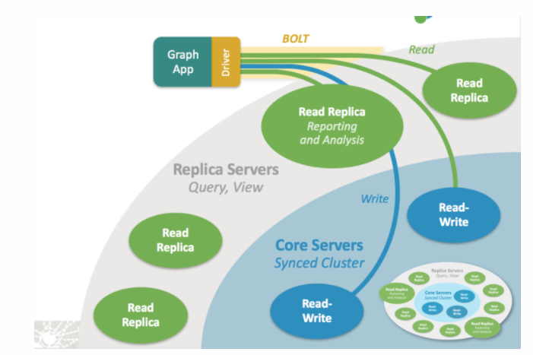
Neo4j – Built in Load Balancing
Load balancing is fully handled by Neo4j Bolt drivers, which operate in concert with the Causal Cluster to spread the workload.
New cluster-aware sessions, managed on the client-side by the Bolt drivers, alleviate complex infrastructure concerns for developers

Slide 25
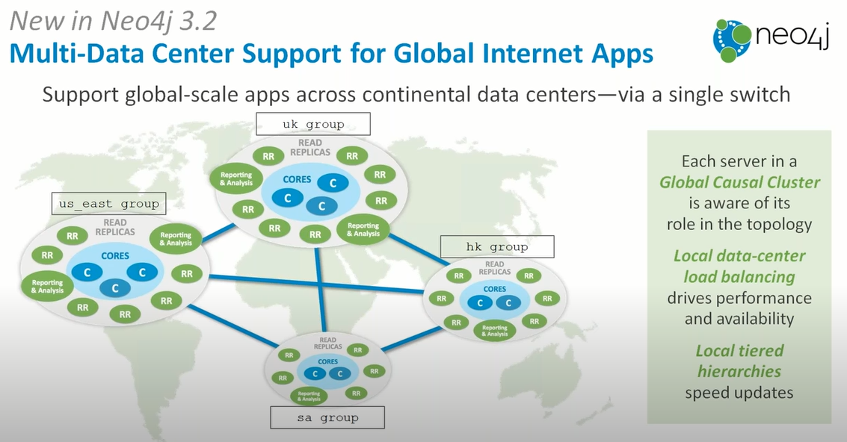

Slide 26
Neo4j – Data Modeling
As with any database management system, but perhaps even more so for a graph database management system such as Neo4j, your queries will drive your model.
There is no one perfect way to model in a graph database such as Neo4j. It will all depend on the questions that you want to ask of the data and this will drive your design and model.
Graph Data Model = Whiteboard-Friendly
In relational world, when designing a data model, people draw example data on the whiteboard and connect it to other data drawn to show how different items connect. The whiteboard model is then re-formatted and structured to fit normalized tables for a relational model.
In graph data modeling, instead of modifying the data model to fit a normalized table structure, the graph data model stays exactly as it was drawn on the whiteboard. This is where the graph data model gets its name for being "whiteboard-friendly".
The ability to easily whiteboard your data model makes the graph data model incredibly simple and visual. There is no need to draw up business model versions or explain ERD terms to business users. Instead, the graph data model is easily understood by anyone.

Slide 27
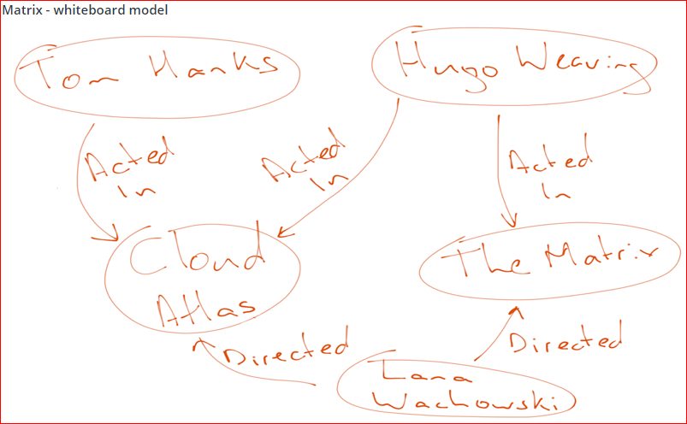
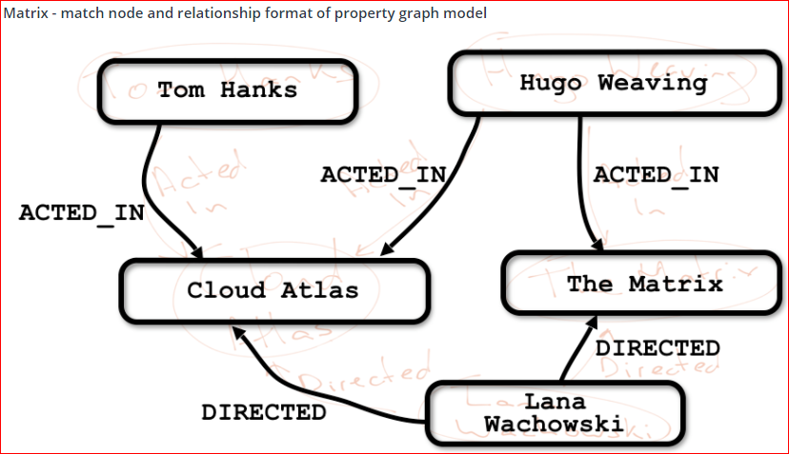
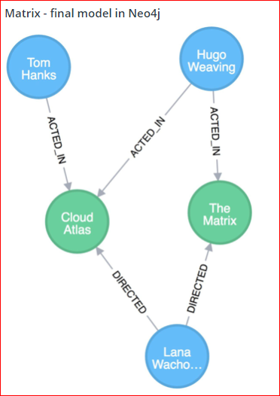
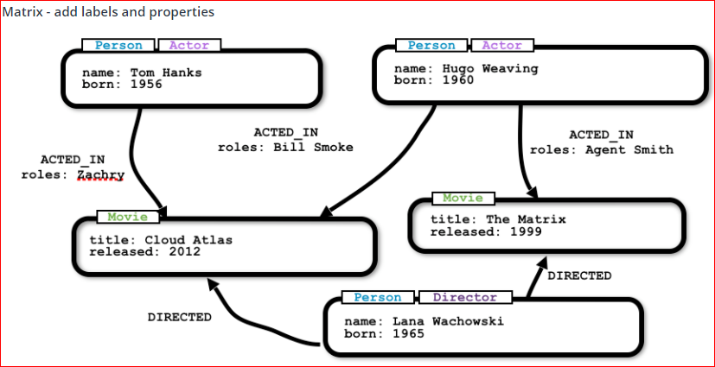
Neo4j – Data Modeling --Whiteboarding

Slide 28


Neo4j – Data Modeling – Process of Designing Graph Data Model
We will take a simple scenario to describe the process of designing the Graph Data Model
In Graph Data Modeling, there are
Nodes
Relationships
Label
Properties
Nodes represent the business entities like person, car, account, company etc. You can often find nodes for the graph model by identifying nouns in your domain/scenario.
First try to identify the business entities and use them as nodes. Conceptually, we assume that node would be a unique.
Nodes are John, Sally and “Graph Database”.

Slide 29
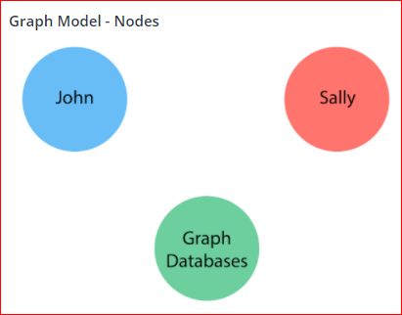

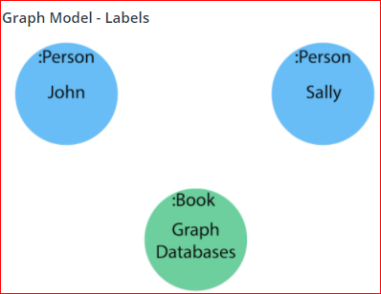
Neo4j – Data Modeling – Process of Designing Graph Data Model
Remember that a graph database takes each instance of an entity as a separate node (John and Sally would be two separate nodes, even though they are both people), and Graph Databases would be a separate node from another book.
A Label is a named graph construct that is used to group nodes into sets. All nodes labeled with the same label belongs to the same set.
Many database queries can work with these sets instead of the whole graph, making queries easier to write and more efficient.
A node may be labeled with any number of labels, including none, making labels an optional addition to the graph.
To find out if we can group objects in our scenario, we will start by identifying the roles of our nodes (John, Sally, Graph Databases) mentioned in the statement.
The labels are “Person” and “Book”.

Slide 30

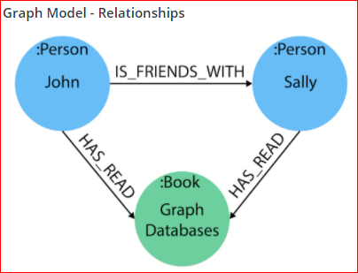
Neo4j – Data Modeling – Process of Designing Graph Data Model
A Relationship connects two nodes and allows us to find related nodes of data. It has a source node and a target node that shows the direction of the arrow.
Although you must store a relationship in a particular direction, Neo4j has equal traversal performance in either direction, so you can query the relationship without specifying direction.
The one core, consistent rule in a graph database is "No broken links", ensuring that an existing relationship will never point to a non-existing endpoint. Since a relationship always has a start and end node, you cannot delete a node without also deleting its associated relationships.
We can often find relationships for the graph model by identifying actions or verbs in your domain. Actions such as DRIVES, HAS_READ, MANAGES, ACTED_IN, and others similar can be defined as different types of relationships to exist between nodes.
Relationships between nodes:
John is friends with Sally
Sally is friends with John
John has read Graph Databases
Sally has read Graph Databases

Slide 31
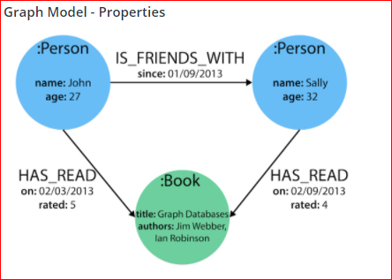
Neo4j – Data Modeling – Process of Designing Graph Data Model
Properties are name-value pairs of data that you can store on nodes or on relationships. Properties allow you to store relevant data about the node or relationship with the entity it describes. They can often be found by knowing what kinds of questions your use case needs to ask of your data.
Questions to ask of our John and Sally data model:
When did John and Sally become friends? Or how long have they been friends?
What is the average rating of the Graph Databases book?
Who is the author of the Graph Databases book?
How old is Sally?
How old is John?
Who is older, Sally or John?
Who read the Graph Databases book first, Sally or John?
From this list of questions, you can identify the attributes that we need to store on the entities within our data model in order to answer these questions.

Slide 32
Neo4j – Data Modeling – Relational to Graph
In a graph, you do not need to worry about table joins and index lookups because graph data is structured by each, individual entity and its relationships with other individual entities.
Relational databases rely upon index lookups and table joins to connect different entities. This quickly becomes a problem for performance, especially when there are several tables joined, millions of rows on tables, or complex queries that traverse various levels through subqueries.
Below are some of the steps and key components useful in translating relational data model to graph datamodel.
Table to Node Label - each entity table in the relational model becomes a label on nodes in the graph model.
Row to Node - each row in a relational entity table becomes a node in the graph.
Column to Node Property - columns (fields) on the relational tables become node properties in the graph.
Business primary keys only - remove technical primary keys, keep business primary keys.
Add Constraints/Indexes - add unique constraints for business primary keys, add indexes for frequent lookup attributes.
Foreign keys to Relationships - replace foreign keys to the other table with relationships, remove them afterwards.
No defaults - remove data with default values, no need to store those.
Clean up data - duplicate data in denormalized tables might have to be pulled out into separate nodes to get a cleaner model.
Index Columns to Array - indexed column names (like email1, email2, email3) might indicate an array property.
Join tables to Relationships - join tables are transformed into relationships, columns on those tables become relationship properties

Slide 33
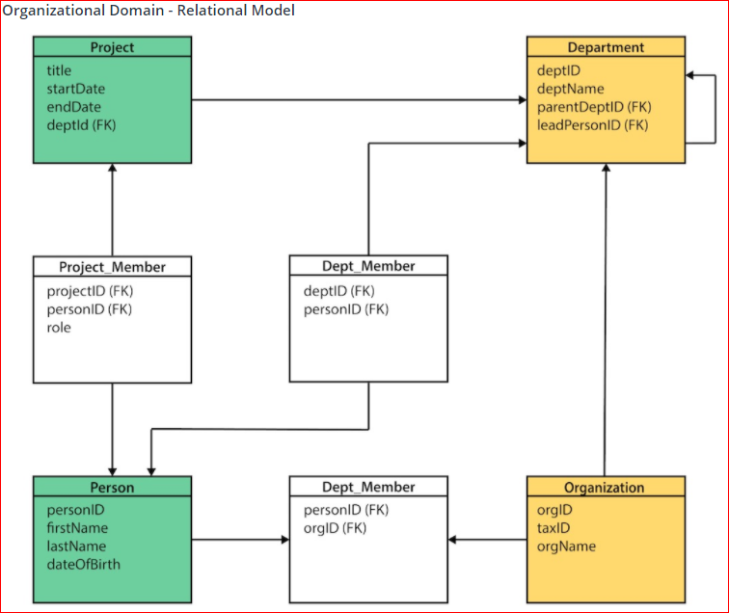
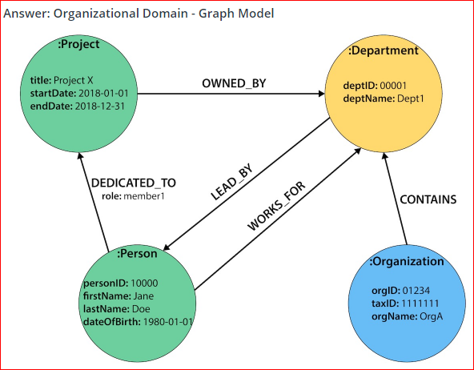
Neo4j – Data Modeling – Relational to Graph
Conversion Steps:
Identify the main business entities/tables. These tables become labels in our graph model.
The rows on our tables become their own nodes and the columns in those rows become the properties on those nodes. Eg row on the Person table will become a node with a name and date of birth as the properties on that node.
Any indexed columns that allow multiple similar values will become an array (such as skill1, skill2, skill3 columns translate to three values stored in an array property on a node).
Remove any surrogate keys only keep the properties that are needed for business requirements. Keep the business primary keys. Add unique constraints for the business primary keys in order to ensure the database will not allow duplicates.
Foreign keys that would aid in relational join lookups are transformed into relationships, as they show the links between the nodes.
Join tables (or associative entity tables) become relationships, as well, with any join table columns moved to relationship properties.
Only store the needed properties in Neo4j, do not store nulls and empty values, remove any default values that may be created in a relational model.
Any duplicate data created to normalize tables or de-normalize for simplicity’s sake needs removed, as it is unneeded in a graph.

Slide 34
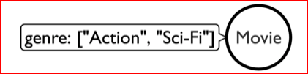
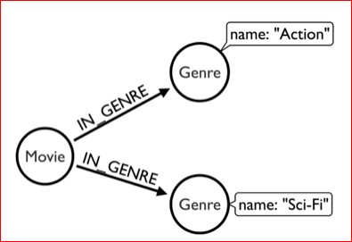
Neo4j – Data Modeling –Why Data Model makes a difference
The requirements are evolving, changing and definitions and meanings also change overtime.
Neo4j is schema-free, which means that your data model can adapt and change easily with your business.
Neo4j allows you to effortlessly adjust detailed and broad changes across pieces or the entirety of the graph.
While designing Graph data model, there are few different ways to look at the same data set and see how each impacts queries and performance for traversing graph data. <https://neo4j.com/developer/modeling-designs/>
Property vs Relationship
Depending upon requirements we can model an attribute as property on a node or as relationship to a separate node.

Slide 35
Neo4j – Data Modeling –Graph Model Refactoring
The requirements are evolving, changing and definitions and meanings also change overtime.
We should be able to evolve your graph model based on changing requirements.
Given the agile approach taken towards building graph models, graph refactoring (or migration) is something that all graph based projects will have to do at some stage. While many graph refactoring can be done using Cypher directly, the APOC library provides tools to make the process easier.
Some of the common refactoring items appear as part of accommodating requirements are
Convert Property to Boolean (Normalize As Boolean)
Extract node from Relationship
Collapse node to Relationship
Clone Subgraphs
Clone nodes
Create node from Property
Renaming
Node labels
Relationship Types
Node Properties
Relationship Properties
Set Relationship Types
Redirect Source or Target Node
Merge Nodes
Invert relationship

Slide 36
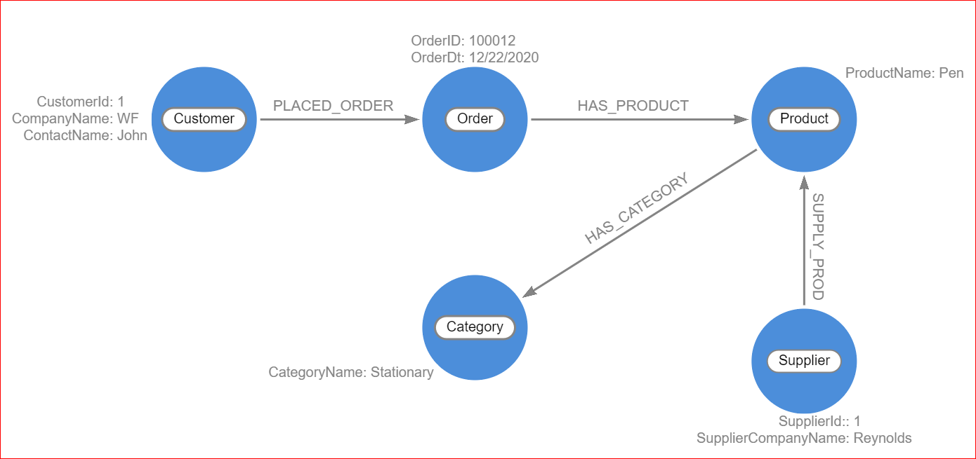
Neo4j – Data Modeling – Tool for drawing Graph
arrows.app is a web-based tool for drawing pictures of graphs and helping in the graph design and modeling activities.
https://arrows.app/
Features
Quick Intuitive drawing with a mouse.
Neo4j Property Graph Model Draw: nodes, relationships, properties, labels.
Fine-grained Styling Control: sizes, layouts, colors.
Export as image or Cypher Use images in documents or presentations. Run Cypher to create graphs in Neo4j.

Slide 37
Neo4j – Cypher Query Language
Cypher is Neo4j’s graph query language that allows users to store and retrieve data from the graph database.
Neo4j’s property graph model is composed of nodes and relationships that build the most valuable and powerful piece of the property graph model - the pattern. Patterns are comprised of node and relationship elements and can express simple or complex traversals and paths.
Pattern recognition is fundamental to the way that the brain works. Because of this, humans are very good at working with patterns.
Cypher is also heavily based on patterns and is designed to recognize various versions of these patterns in data, making it a simple and logical language for users to learn.
Cypher’s syntax provides a visual and logical way to match patterns of nodes and relationships in the graph.
Cypher is open source.
It is a declarative, SQL-inspired language for describing visual patterns in graphs using ASCII-Art syntax.
Through Cypher, users can construct expressive and efficient queries to handle needed create, read, update, and delete functionality from our graph data without a description of exactly how to do it.

Slide 38
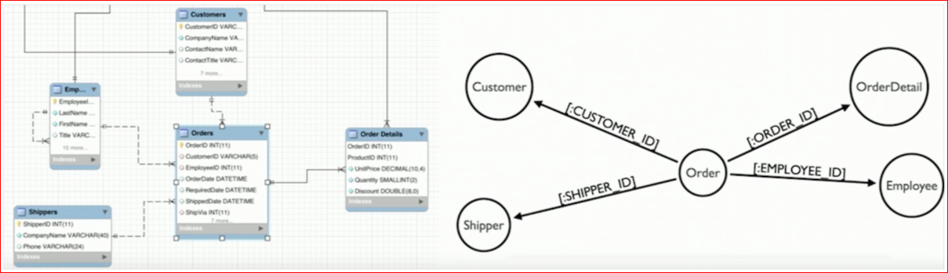
Neo4j – ETL Tool - Interactive Relational Database Data Import
The Neo4j ETL tool was developed to import the data from relational systems into Neo4j.
It extracts the schema from any relational database and allows to turn it into the graph schema you need.
Then it takes care of importing the data into your graph either in bulk or online mode.
You don’t need to know Cypher to use this tool, it takes care of all the heavy-lifting.
Functionality Includes
Neo4j-ETL Graph App in Neo4j Desktop
Manage multiple RDBMS connections
automatically extract database metadata from relational database
derive graph model
visually edit labels, relationship-types, property-names and types
visualize current model as a graph
persist mapping as json
retrieve relevant CSV data from relational databases
run bulk or online-import
bundles MySQL, PostgreSQL, allows custom JDBC driver with Neo4j Enterprise

Slide 39
Neo4j – Fabric
Fabric, introduced in Neo4j 4.0, is a way to store and retrieve data in multiple databases using a single Cypher query. Databases may be on the same Neo4j DBMS or in multiple DBMSs.
Fabric enables
a unified view of local and distributed data, accessible via a single client connection and user session
increased scalability for read/write operations, data volume and concurrency
predictable response time for queries executed during normal operations, a failover or other infrastructure changes
High Availability and No Single Point of Failure for large data volume.
Fabric provides the infrastructure and tooling for:
Data Federation: the ability to access data available in distributed sources in the form of disjointed graphs.
Data Sharding: the ability to access data available in distributed sources in the form of a common graph partitioned on multiple databases.
A Fabric setup includes a Fabric virtual database, which acts as the entry point to a federated or sharded graph infrastructure. This database is the execution context in which multi-graph queries can be executed.
The Fabric virtual database (execution context) differs from normal databases in that it cannot store any data, and only relays data stored elsewhere.
The Fabric virtual database can be configured on a standalone Neo4j DBMS only, i.e. on a Neo4j DBMS where the configuration setting dbms.mode must be set to SINGLE.
In a Fabric virtual database, data is organized in the form of graphs. Graphs are seen by client applications as local logical structures, where physically data is stored in one or more databases. Databases accessed as Fabric graphs can be local, i.e in the same Neo4j DBMS, or they can be located in external Neo4j DBMSs.

Slide 40
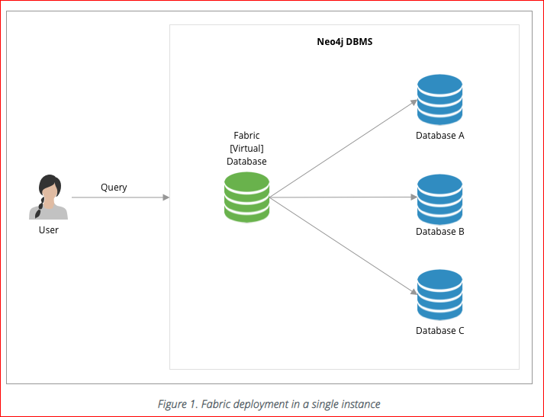
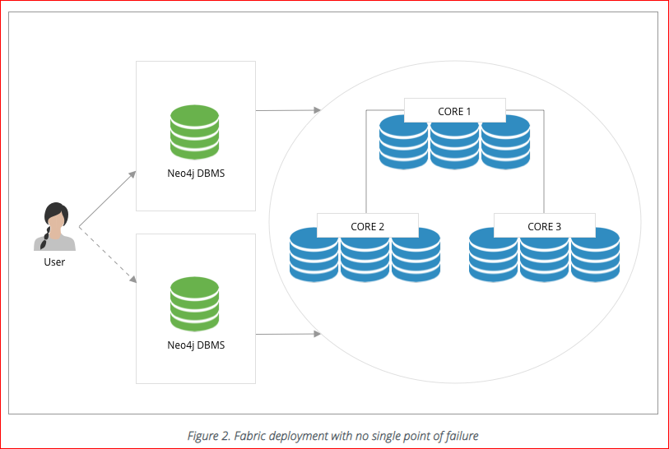
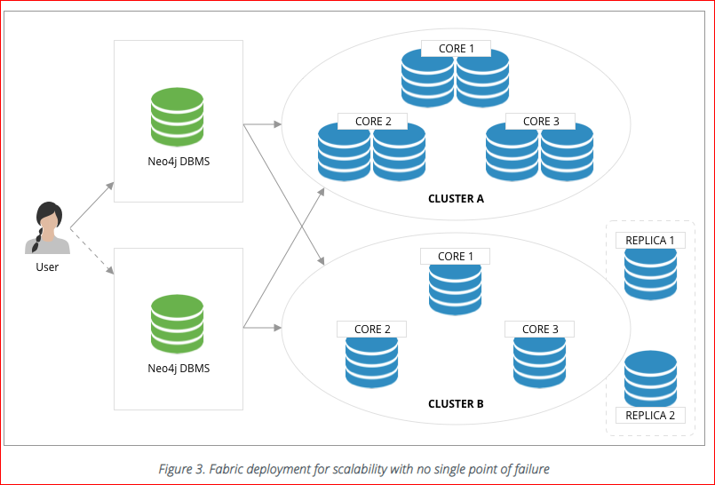
Neo4j – Fabric Deployment Topologies
Development deployment
In its simplest deployment, Fabric can be used on a single instance, where Fabric graphs are associated to local databases. This approach is commonly used by software developers to create applications that will be deployed on multiple Neo4j DBMSs, or by power users who intend to execute Cypher queries against local disjoint graphs.
Cluster deployment with no single point of failure
In this deployment Fabric guarantees access to disjoint graphs in high availability with no single point of failure. Availability if reached by creating redundant entry points for the Fabric Database (i.e. two standalone Neo4j DBMSs with the same Fabric configuration) and a minimum Causal Cluster of three members for data storage and retrieval. This approach is suitable for production environments and it can be used by power users who intend to execute Cypher queries against disjoint graphs.
Multi-cluster deployment
In this deployment Fabric provides high scalability and availability with no single point of failure. Disjoint clusters can be sized according to the expected workload and Databases may be colocated in the same cluster or they can be hosted in their own cluster to provide higher throughput. This approach is suitable for production environments where database can be sharded, federated or a combination of the two.

Slide 41
Neo4j – Streaming Data Integration
There are multiple use-cases where there is a need to integrate Kafka with Neo4j either to ingest data into the graph Or to send update events (change data capture - CDC) to the event log for later consumption.
Neo4j Streams can run in two modes:
as a Neo4j plugin:
Neo4j Streams Source: a transaction event handler events that sends data to a Kafka topic
Neo4j Streams Sink: a Neo4j application that ingest data from Kafka topics into Neo4j via templated Cypher Statements
Neo4j Streams Procedures: two procedures streams.publish, which allows custom message streaming from Neo4j to the configured environment, and streams.consume which allows to consume messages from a given topic.
as a Kafka-Connect Plugin:
A plugin for the Confluent Platform that allows to ingest data into Neo4j, from Kafka topics, via Cypher queries. At the moment it offers only the Sink functionality.

